Slide 1
VEGIBLE

Slide 2
VEGIBLE
Our online vegetable selling website offers a wide variety of seasonal vegetables sourced directly from local farmers, ensuring the best quality produce for our customers.

Slide 3
TABLE OF CONTENTS
01
02
03
LOG IN
REGISTER
HOME PAGE
Identifying and authenticating the user
Creation of account if the user is new to the website
Main page of the application where you interface

Slide 4
CONTENTS OF VEGIBLE
Here’s what you’ll find in this Vegible web application:
Logging in allows you to access your account and view your information. You can also log in to make changes to your account or to view account activity.
This process will only take a few minutes of your time and will provide us with the information we need to get you started. We appreciate your interest in our program and look forward to working with you.
The home screen is the starting point for using your device. It's where you can chat with your friends with who are available on the website
Now we’re ready to get started .

Slide 5
FRONT END
REACT
HTML & CSS
It's used for building interactive user interfaces and web applications quickly and efficiently with significantly less code than JavaScript. In React, you develop your applications by creating reusable components that you can think of as independent Lego blocks.
HTML (HyperText Markup Language) basically is the code that is used to structure a web page and its content. CSS (Cascading Style Sheets) is used to style and layout web pages

Slide 6
BACKEND
NODE.JS
XPRESS.JS
MONGODB
Allows you to run JavaScript on the server
Minimal and flexible
Node.js web app framework
An open-source document-oriented database

Slide 7
LOG-IN
01
Getting Started

Slide 8
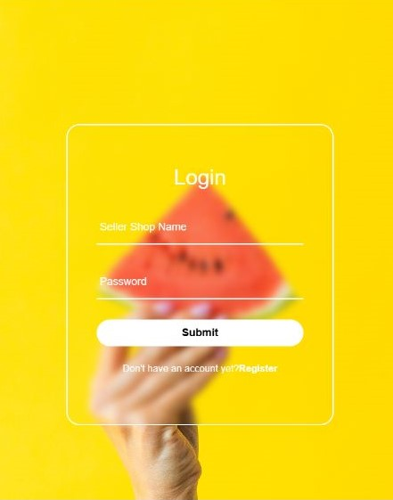
LOG-IN
USERNAME
PASSWORD
LOG-IN
Enter your credentials to login
Then enter your password to proceed
Click Log in and you’re ready to go

Slide 9
REGISTER
02
CREATE AN ACCOUNT TO GET STARTED .

Slide 10
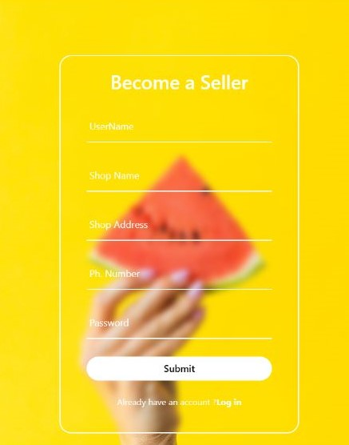
REGISTER
USERNAME
EMAIL
PASSWORD
Since you don’t have account registered . Follow there steps to get started
Choose a unique username
Enter the email you want to add with your username
Secure your account and chats with a password .

Slide 11
HOME
03

Slide 12
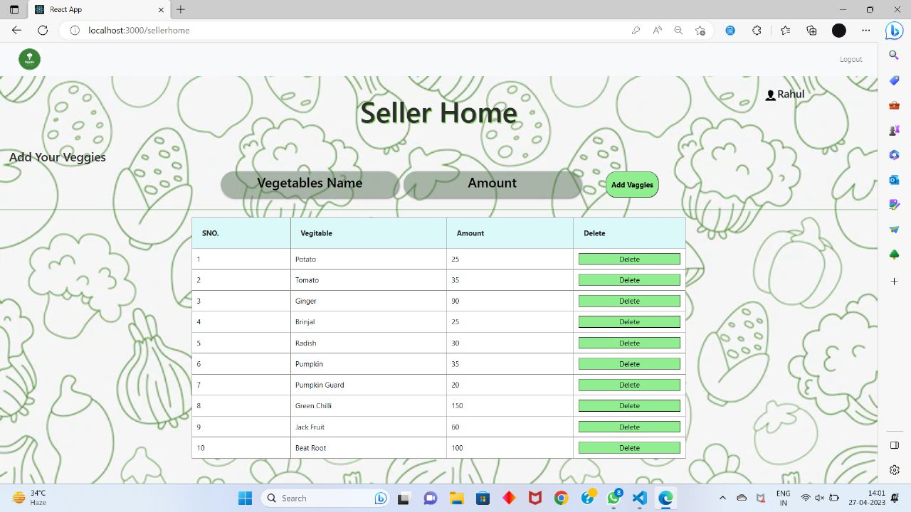
SELLER HOME .
It will be home of page of seller.
Here he/she can see which vegetables he has uploaded on website

Slide 13
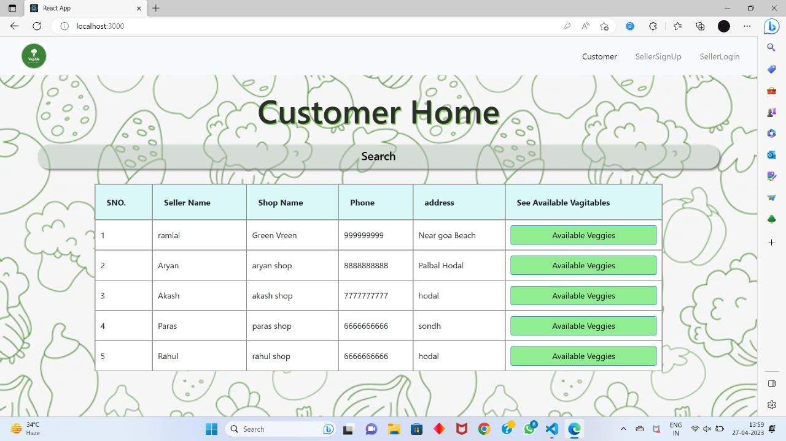
CUSTOMER HOME ..
It will show list of all vegetable sellers
Here user can see the address and mobile number of the seller
From Here user can contact to vegetable seller easily and directly.

Slide 14
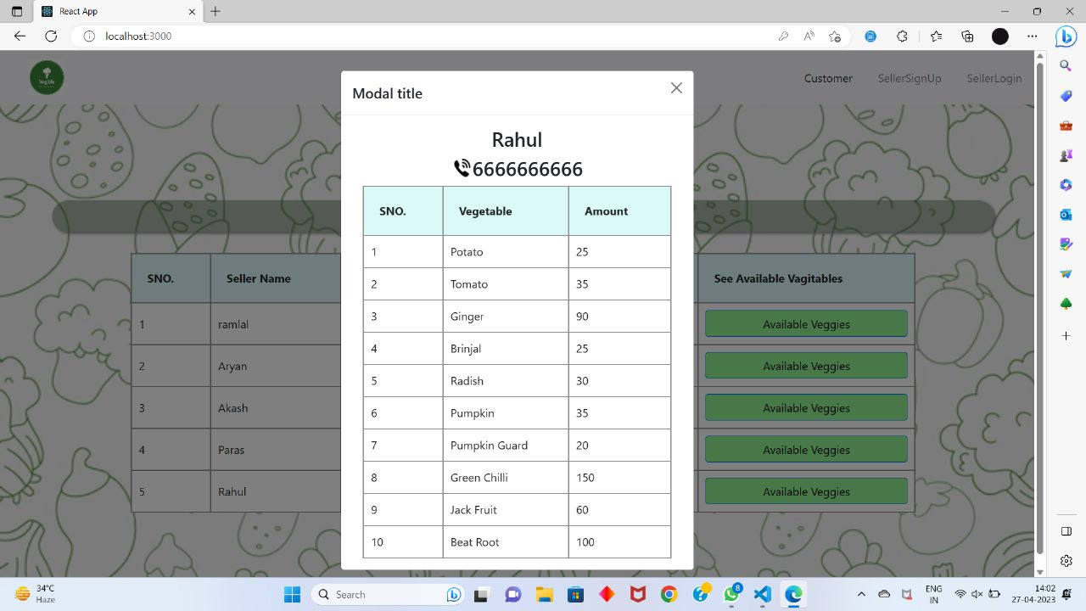
LIST OF SELLER’S VEGETABLE
Here customer can see list of all vegetable of a particular vegetable seller.
Customer can also see the amount of the vegetable a particular vegetable seller can provide to you.

Slide 15
THANKS
Do you have any questions?
~ Sourabh, Nishant Dwivedi, Shatrughan Singh Bisen, Aryan
~ Mr. Bhanu Kapoor(Mentor)

